Slide 1
Object Oriented Programming: Overview
Gokkul Nath T S (EGOKKUL)

Slide 2
agenda
Functions, Lambda
Function Argument Types
Exception handling
Classes and Objects
Object Relationship
Constructor vs Initializer
Inheritance
Multiple Inheritance and its complications
Case Study: Library Catalog
Private Methods/Attributes in Python ??

Slide 3
Quick Recap: Session 1
Python Intro, Use Cases and benefits
Object Mutability: id, type
Lists, Tuple, dictionary and sets : Creation, updating the value and other operations
Various operation on Strings: split, strip, find, replace etc..
Conditional Constructs: if else
Looping Constructs : for , while
Questions/Clarifications?

Slide 4
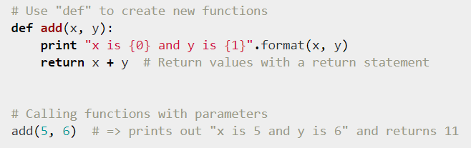
Functions
A function is a group of statements that can be call with a name of that function. Function defines within class statement also called method
In Python, We can pass a function as an argument to other function and also can return another function as return statement
The first string in the function body is called the function documentation string. It is used to document the function
A doc string is a string literal that occurs as the first statement in a module, function, class, or method definition.

Slide 5
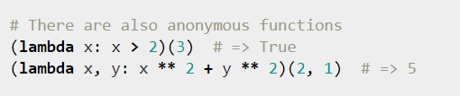
Lamda Functions
Anonymous function :
Instead of using “def” keyword used “lambda” to create an anonymous function
“lambda” can take any number of arguments but return only one expression (don’t have explicit return)
“lambda” can ’t contain multiple expressions or commands
It can’t call direct to print as lambda expect an expression
Note: lambda is an expression whereas def is a statement. Since lambda is an expression, it can only contain other expressions (no statements are allowed)

Slide 6
Function Arguments
In Python every variable contains the reference of real object.
So every variable we pass in function is pass by reference
but if it’s string or number object and we want to change that variable than it creates a local copy of that variable
And in case of list or dictionary or sets it’s always pass by reference
Type of Arguments:
We can call a function with following type of arguments:
Required Arguments
Optional/Default Arguments
Variable length Arguments
Keyword Arguments

Slide 7


Required Arguments:
In this type arguments have no default values.
It’s simplest form of arguments and their order is main point for access.
if we missed any required argument while calling function than python will produce error.
Optional Arguments:
Arguments are not mandatory (Optional) and have default values. If signature is more difficult to remember than using keyword arguments with default values is helpful.

Slide 8
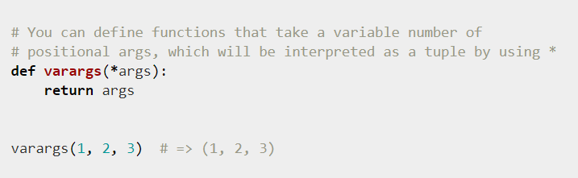
Variable length Arguments:
The arbitrary argument list is the third type to pass arguments to a function.
Intention is a signature with an extensible number of positional arguments it can be defined with the *args constructs.
In the function body, args will be a tuple of all the remaining positional arguments.It’s simplest form of arguments and their order is main point for access.

Slide 9
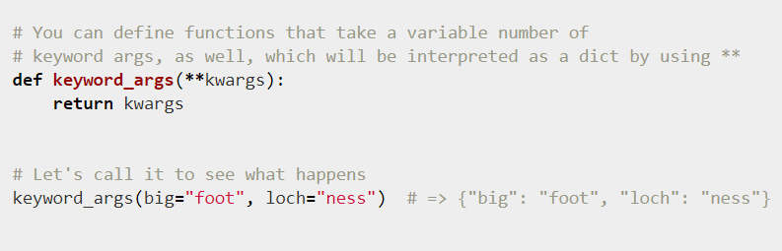
Keyword Arguments:
The arbitrary keyword argument dictionary is the fourth type to pass arguments to functions.
If the function requires an undetermined series of named arguments, it is possible to use the **kwargs construct

Slide 10
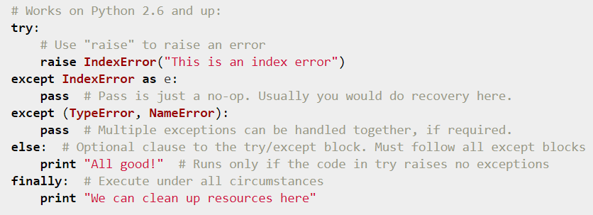
Handling exceptions
Common List of Errors: SyntaxError, IndentationError, TypeError
AttributeError, ImportError, IndexError, KeyError, KeyboardInterrupt, NotImplementedError, StopIteration. For more Details: https://docs.python.org/3/library/exceptions.html

Slide 11
Object Oriented Paradigm : Intro
Object Oriented Paradigm models complex systems by describing a collection of interacting objects via their data and behavior.
Three Stages:
Analysis: Process of looking at a problem, system, or task and identifying the objects and interactions between those objects. (What?)
Design: process of converting such requirements into an implementation specification. (How?)
Programming : process of converting this perfectly defined design into a working program.(Implementation)
Object is a collection of data with associated behaviors. Classes describe objects. They are like blueprints for creating an object.
Objects are also instances of classes that can be associated with each other. An object instance is a specific object with its own set of data and behaviors;
The data in each object can be in a different state from other objects of the same class, and each object may react to method calls differently because of the differences in state.

Slide 12
Attributes are frequently referred to as members or properties. Some authors suggest that the terms have different meanings, usually that attributes are settable, while properties are read-only. In Python no difference between attributes and properties (No read only variables)
Attribute types are often primitives such as integer, floating-point number, string, byte, or Boolean. However, they can also represent data structures such as lists, trees, or graphs, or most notably, other classes
Behaviors are actions that can occur on an object. The behaviors that can be performed on a specific class of objects are called methods. At the programming level, methods are like functions, but they magically have access to all the data associated with this object. Like functions, methods can also accept parameters and return values.
Parameters to a method are a list of objects that need to be passed into the method that is being called (the objects that are passed in from the calling object are usually referred to as arguments). These objects are used by the method to perform whatever behavior or task it is meant to do. Returned values are the results of that task.

Slide 13
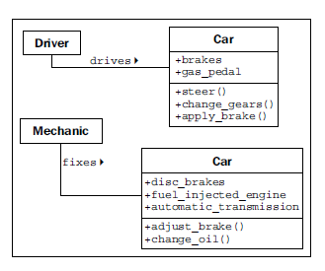
Interface: It is the collection of attributes and methods that other objects can use to interact with that object. They do not need, and are often not allowed, to access the internal workings of the object.
Encapsulation: The process of hiding the implementation, or functional details, of an object is suitably called information hiding. Encapsulated data is not necessarily hidden
When designing public interfaces, keep it simple. Always design the interface of an object based on how easy it is to use, not how hard it is to code
Abstraction means dealing with the level of detail that is most appropriate to a given task . (Driver vs Mechanic Knowledge on Car). In Python, it is the process of encapsulating information with separate public and private interfaces. The private interfaces can be subject to information hiding

Slide 14
Things to Remember when modelling
Make our models understandable to other objects that have to interact with them. This means paying careful attention to small details.
Ensure methods and properties have sensible names.
When analyzing a system, objects typically represent nouns in the original problem, while methods are normally verbs. Attributes can often be picked up as adjectives, although if the attribute refers to another object that is part of the current object, it will still likely be a noun.
Don't try to model objects or actions that might be useful in the future. Model exactly those tasks that the system needs to perform, and the design will naturally gravitate towards the one that has an appropriate level of abstraction.
Our designs should be open ended so that future requirements can be satisfied. However, when abstracting interfaces, try to model exactly what needs to be modeled and nothing more
When designing the interface, try placing yourself in the object's shoes and imagine that the object has a strong preference for privacy. Don't let other objects have access to data about you unless you feel it is in your best interest for them to have it. Don't give them an interface to force you to perform a specific task unless you are certain you want them to be able to do that to you.

Slide 15
Object Relationships
Association: (is related to)
Association refers to the relationship between multiple objects. It refers to how objects are related to each other and how they are using each other's functionality. Composition and aggregation are two types of association.
Composition: (is made up of) (Car parts : Engine, transmission, starter, headlights etc )
Composition is the act of collecting several objects together to create a new one. Composition is usually a good choice when one object is part of another object.
The composition is the strong type of association. An association is said to composition if an Object owns another object and another object cannot exist without the owner object.
Eg. Consider the case of Human having a heart. Here Human object contains the heart and heart cannot exist without Human.

Slide 16
Object Relationships
Aggregation (can be grouped as ):
Aggregation is a weak association. An association is said to be aggregation if both Objects can exist independently.
Eg. For example, a Team object and a Player object. The team contains multiple players but a player can exist without a team.
Note:
If the composite (outside) object controls when the related (inside) objects are created and destroyed, composition is most suitable.
If the related object is created independently of the composite object, or can outlast that object, an aggregate relationship makes more sense.
Any composite relationship is also an aggregate relationship, but not vice versa.

Slide 17
Misc Concepts
Inheritance : The is a relationship is formed by inheritance. Inheritance is the most famous, well-known, and over-used relationship in object-oriented programming.
Polymorphism : Polymorphism is the ability to treat a class differently depending on which subclass is implemented. In Python, a subclass of an object is to be treated like a parent class.
This sort of polymorphism in Python is typically referred to as duck typing: "If it walks like a duck or swims like a duck, it's a duck". We don't care if it really is a duck (inheritance), only that it swims or walks.
Eg. Geese and swans might easily be able to provide the duck-like behavior we are looking for.

Slide 18
Multiple Inheritance
Object-oriented design can also feature such multiple inheritance, which allows a subclass to inherit functionality from multiple parent classes.
Multiple inheritance can be a tricky business, and some programming languages (most notably, Java) strictly prohibit it.
Example: An object designed to connect to a scanner and send a fax of the scanned document might be created by inheriting from two separate scanner and faxer objects
As long as two classes have distinct interfaces, it is not normally harmful for a subclass to inherit from both of them. it gets messy if we inherit from two classes that provide overlapping interfaces.
Note : Inheritance is the perfect solution for obvious is a relationships, but it can be abused. Programmers often use inheritance to share code between two kinds of objects that are only distantly related, with no is a relationship in sight. While this is not necessarily a bad design, it is a terrific opportunity to ask just why they decided to design it that way, and whether a different relationship or design pattern would have been more suitable.

Slide 19
Case Study : Library Catalog
Problem Description : The system we'll be modeling is a library catalog. Libraries have been tracking their inventory for centuries, originally using card catalogs, and more recently, electronic inventories. Modern libraries have web-based catalogs that we can query from our homes
Analysis:
Catalogs contain lists of books.
People search them to find books on certain subjects, with specific titles, or by a particular author.
Books can be uniquely identified by an International Standard Book Number (ISBN).
Each book has a Dewey Decimal System (DDS) number assigned to help find it on a particular shelf.
Book as the most important object, with several attributes already mentioned, such as author, title, subject, ISBN, and DDS number, and catalog as a sort of manager for books.

Slide 20
Analysis (Continued)
We might want to search a book by author is an author_ name attribute on the book. However, authors are also objects, and we might want to store some other data about the author.
But some books can have multiple authors. Suddenly, the idea of having a single author_name attribute on objects seems a bit silly. A list of authors associated with each book is clearly a better idea.
Understanding Relationship:
The relationship between author and book is clearly association, since you would never say, "a book is an author" (it's not inheritance), and saying "a book has an author", though grammatically correct, does not imply that authors are part of books (it's not aggregation). Indeed, any one author may be associated with multiple books.
Is a shelf an object that needs to be modeled in a cataloging system?
DDS was designed to help locate physical books in a library. As such, storing a DDS attribute with the book should be enough to locate it, regardless of which shelf it is stored on. So we can, at least for the moment, remove shelf from our list of contending objects.

Slide 21
Analysis (Continued)
Another questionable object in the system is the user. Do we need to know anything about a specific user, such as their name, address, or list of overdue books?
For cataloging purposes, we decide we don't need to identify the user for now. We can assume that a user will be searching the catalog, but we don't have to actively model them in the system, beyond providing an interface that allows them to search.
What about behaviors?
The catalog clearly needs a search method, possibly separate ones for authors, titles, and subjects. Are there any behaviors on books? Would it need a preview method? Or could preview be identified by a first pages attribute instead of a method?

Slide 22
Analysis (Continued)
Libraries don't serve only books, they also have DVDs, magazines, and CDs, none of which have an ISBN or DDS number. All of these types of items can be uniquely identified by a UPC number though.
We remind the librarian that they have to find the items on the shelf, and these items probably aren't organized by UPC.
The librarian explains that each type is organized in a different way. Say,The CDs are mostly audio books, and they only have a couple of dozen in stock, so they are organized by the author's last name. DVDs are divided into genre and further organized by title
With no previous object-oriented design experience, we might consider adding separate lists of DVDs, CDs, magazines, and books to our catalog, and search each one in turn.
The trouble is, except for certain extended attributes, and identifying the physical location of the item, these items all behave as much the same. This is a job for inheritance!

Slide 23
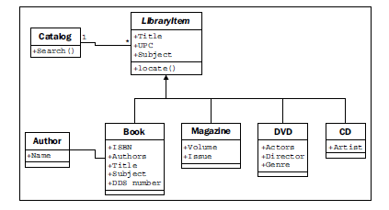
Analysis (Continued)
Unfortunately, our class diagram so far is still a messy design. We notice that actors on DVDs and artists on CDs are all types of people, but are being treated differently from the book authors.
The librarian also reminds us that most of their CDs are audio books, which have authors instead of artists.
How can we deal with different kinds of people that contribute to a title?
Answer: For cataloging purposes, it is probably enough to know how the person contributed to the item. We recognize that all items have one or more Contributor objects, so we move the author relationship from the book to its parent class .

Slide 24
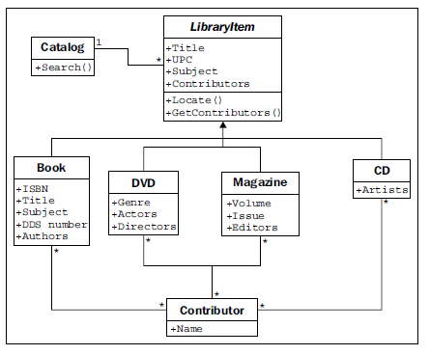
Analysis (Continued)
The multiplicity of the Contributor/LibraryItem relationship is many-to-many, as indicated by the * character at both ends of one relationship. Any one library item might have more than one contributor
For example: several actors and a director on a DVD. And many authors write many books, so they would be attached to multiple library items.

Slide 25
Key Takeaways:
Always try to perform a basic object-oriented analysis.
Identify the requirements and the interacting objects.
Sketch out a class diagram featuring the highest level of abstraction on that system. Identify the major interacting objects.
Identify minor supporting objects. Go into detail for the attributes and methods of some of the most interesting ones.
Take different objects to different levels of abstraction. Look for places you can use inheritance or composition.
Look for places you should avoid inheritance.
These steps not only helps you design systems it will help you boost your understanding of implemented systems. Especially modules/libraries that you use.

Slide 26
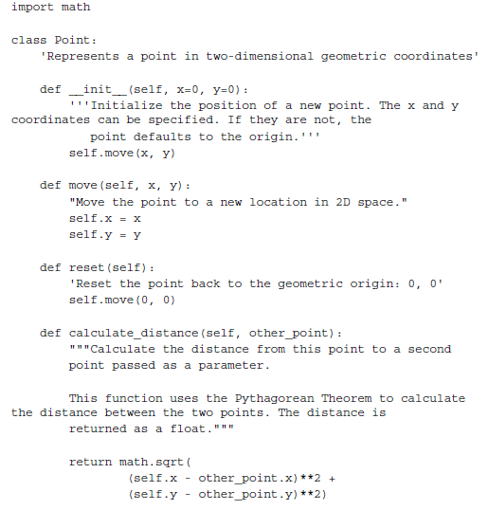
Classes
Classes describe objects. They are like blueprints for creating an object.
The one difference between methods and normal functions is that all methods have one required argument. This argument is conventionally named self;
The self argument to a method is simply a reference to the object that the method is being invoked on.
Quick Tip: When you see an error message that indicates missing arguments, the first thing to check is whether you forgot self in the method definition.

Slide 27
Classes (Continued)
All Python classes are subclasses of the special class named object (implicitly done by python). This class provides very little in terms of data and behaviors (the behaviors it does provide are all double-underscore methods intended for internal use only), but it does allow Python to treat all objects in the same way.
A superclass, or parent class, is a class that is being inherited from. A subclass is a class that is inheriting from a superclass. A subclass is also said to be derived from its parent class or that the subclass extends the parent.
Built-in types can be extended based on requirements. Commonly extended built-ins are object, list, set, dict, file, and str.
Overriding means altering or replacing a method of the superclass with a new method (with the same name) in the subclass. No special syntax is needed to do this; the subclass's newly created method is automatically called instead of the superclass's method

Slide 28
Constructor vs Initializer a.k.a __new__ vs __init__
Python is a little different; it has a constructor and an initializer. The constructor function is rarely used unless you're doing something exotic.
Python initialization method is the same as any other method, except it has a special name, __init__
You may never need to use the other Python constructor, but it helps to know it exists.
The constructor function is called __new__ as opposed to __init__, and accepts exactly one argument; the class that is being constructed (it is called before the object is constructed, so there is no self argument). It also has to return the newly created object.
Note: Never name a function of your own with leading and trailing double underscores. It may mean nothing to Python, but there's always the possibility that the designers of Python will add a function that has a special purpose with that name in the future, and when they do, your code will break.

Slide 29
Miscellaneous
A docstring should clearly and concisely summarize the purpose of the class or method it is describing. It should explain any parameters whose usage is not immediately obvious, and is also a good place to include short examples of how to use the API.
As our projects grow, it can become difficult to find the one class that needs to be edited among the many classes we've defined. We modularizes the code my creating separate modules. Modules are simply Python files, nothing more. The single file in our small program is a module.
A package is a collection of modules in a folder.

Slide 30
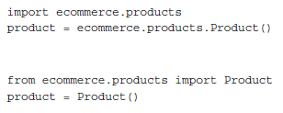
Absolute imports and Relative imports
Absolute imports specify the complete path to the module, function, or path we want to import.
Relative imports are basically a way of saying find a class, function, or module as it is positioned relative to the current module.
From Current Directory
From Directory one level up

Slide 31
Private Methods/Attributes in Python ??
Python doesn’t provide private methods or attributes, it provides unenforced guidelines and best practices. Technically, all methods and attributes on a class are publicly available.
we can put a note in docstrings indicating that the method is meant for internal use only.
By convention, we should also prefix an attribute or method with an underscore character, _. Python programmers will interpret this as "this is an internal variable, think three times before accessing it directly".
Another way to prevent outside objects don't access a property or method: prefix it with a double underscore, __. This will perform name mangling on the attribute in question.
Still the method can still be called by outside objects if they really want to do it, but it requires extra work and is a strong indicator that you demand that your attribute remains private.
Note: When we use a double underscore, the property is prefixed with _<classname>. When methods in the class internally access the variable, they are automatically unmangled. When external classes wish to access it, they have to do the name mangling themselves.

